Slide 1
David Bonnett Associates
York Central Masterplan
Struan Cameron
Dr Alan J Pottinger
Shannon Keys

Slide 2
Agenda
Introduction
Masterplan Experience
York Experience
Our role on York Central
2

Slide 3
1. Introduction

Slide 4
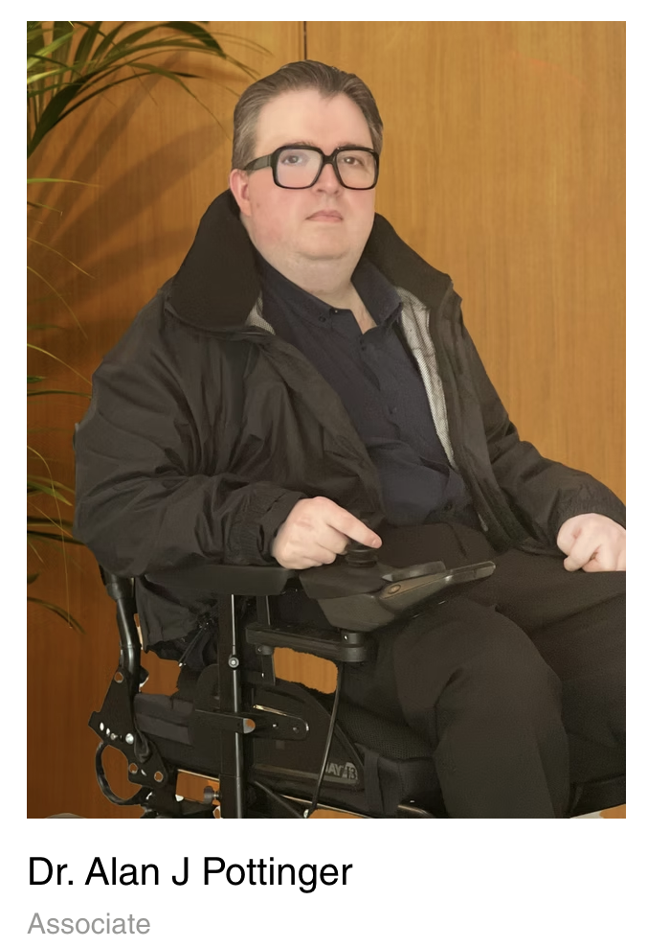

Introduction

Slide 5
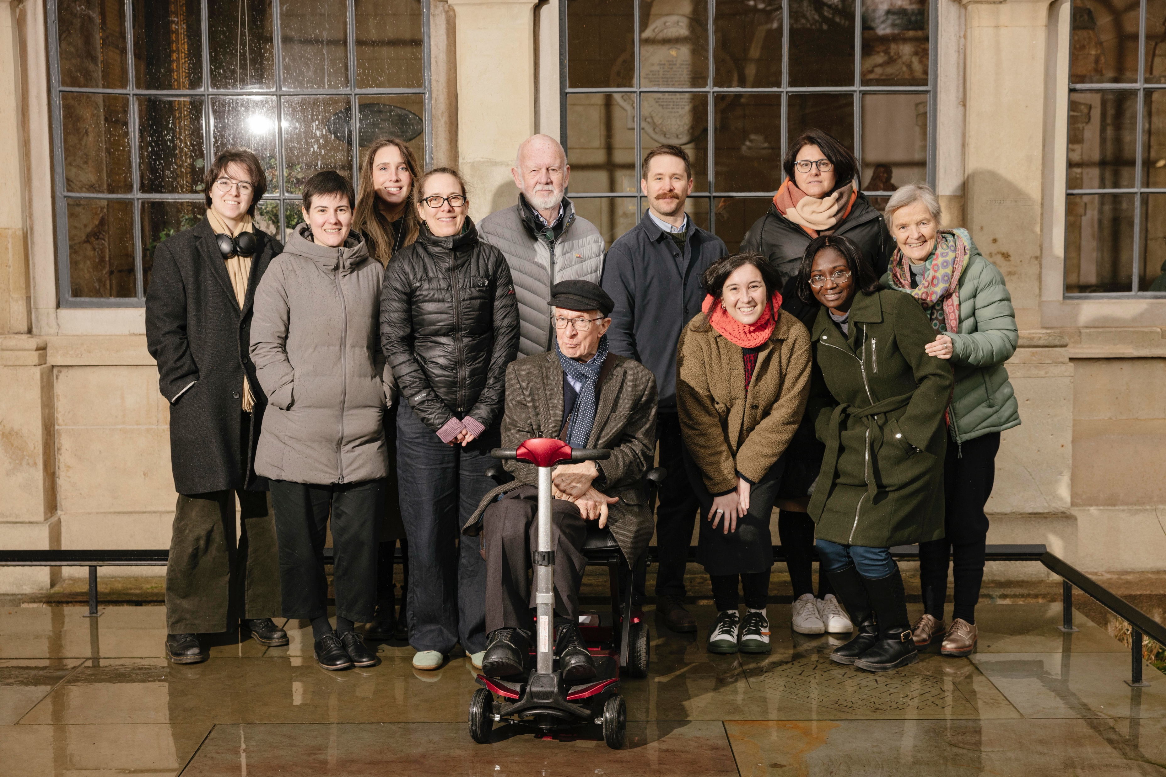
David Bonnett Associates (DBA)
5

Slide 6
About us
DBA is a leading independent consultancy in inclusive design.
London-based, working nationwide across transport, residential, education, workplace, culture, commercial and major urban masterplan projects.
RIBA Chartered Practice with a multidisciplinary approach, combining design expertise, legislation, and user experience.
30 years: DBA has shaped national policy and guidance and contributed to award-winning projects including Stirling Prize winners.

Slide 7
2. Masterplan Experience

Slide 8
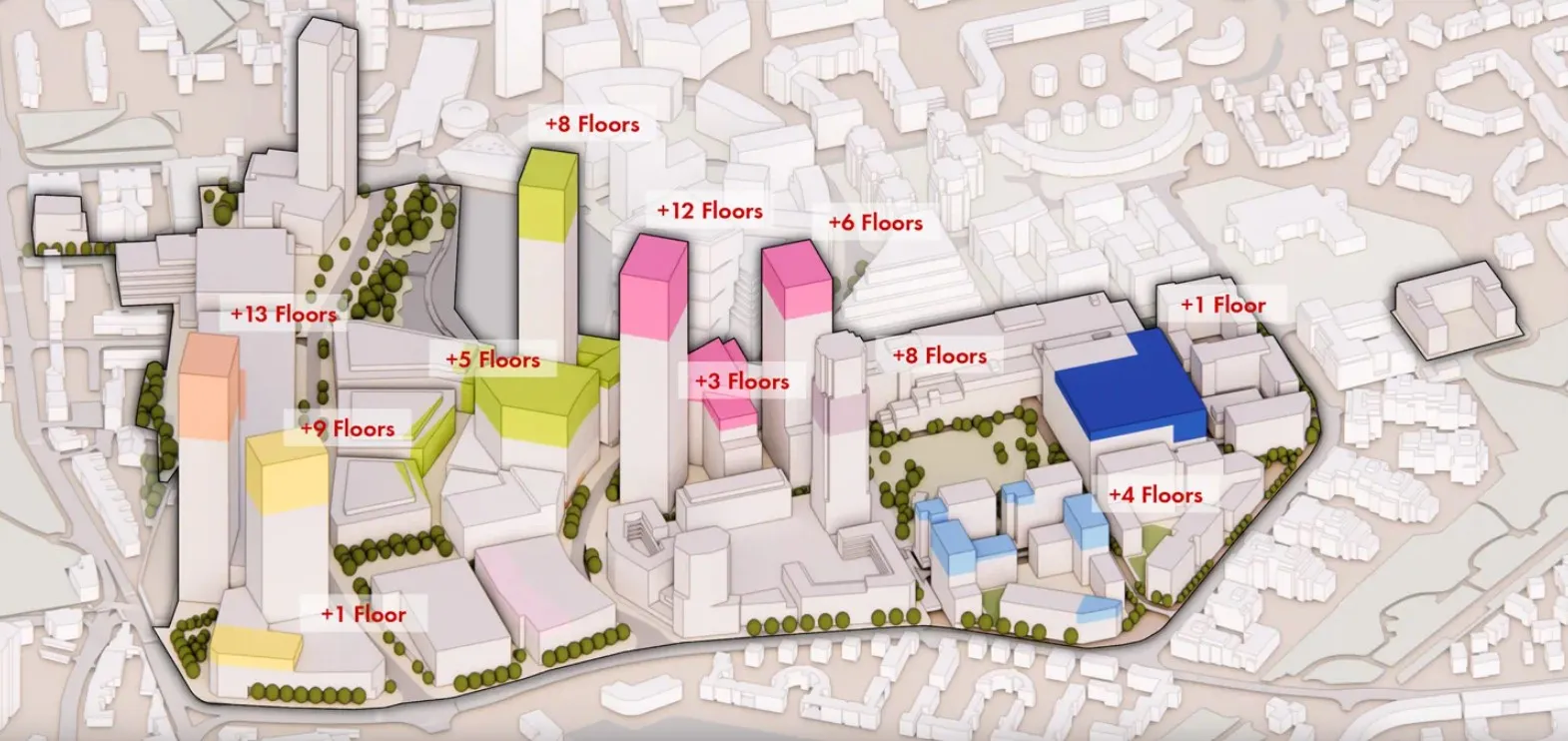
Canada Water Masterplan

Slide 9
Canada Water Masterplan
53-acre mixed-use regeneration project in London, delivering homes, offices, retail, leisure, community uses, and public realm.
DBA produced Inclusive Design Guidelines based on a user journey.
Pedestrian-first strategy with safe, step-free, and accessible routes.
Clear and consistent wayfinding, inclusive public spaces, and sensory design features.
Integrated with transport networks, reducing vehicle dominance and supporting accessible cycling and mobility.
Notes:
what says the policy
what are the social expectations
how the masterplan OPP responded and Phase 1 is continuing
who will benefit
consideration for all the needs, visible and invsible disabilities

Slide 10
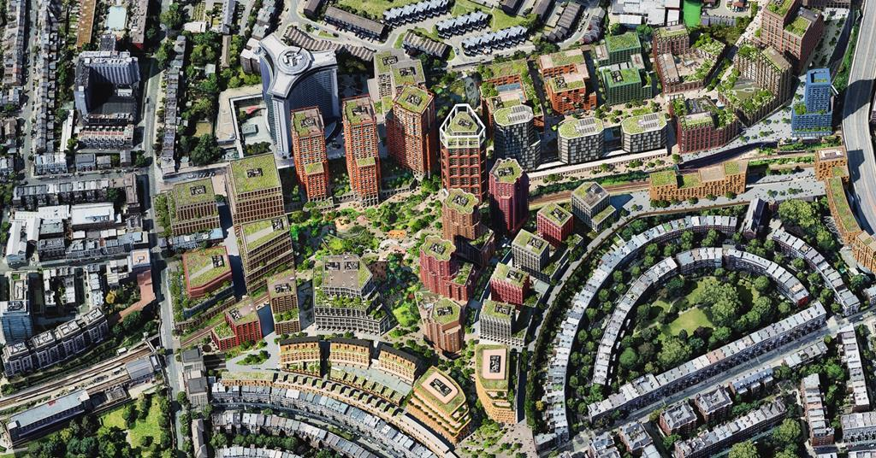
Earls Court Masterplan

Slide 11
Earls Court Masterplan
Earls Court Masterplan: large mixed-use regeneration.
4,000 new homes, 2.9m sq. ft. of workspace, and 100+ shops and Food & Beverage
20 acres of public realm, including a 4.5-acre urban park & community spaces.
Three major cultural venues plus pop-up and seasonal events.
DBA engaged through the Public Realm Inclusivity Panel, ensuring inclusive design is embedded across the project.
Notes:
what says the policy
what are the social expectations
how the masterplan OPP responded and Phase 1 is continuing
who will benefit
consideration for all the needs, visible and invsible disabilities

Slide 12
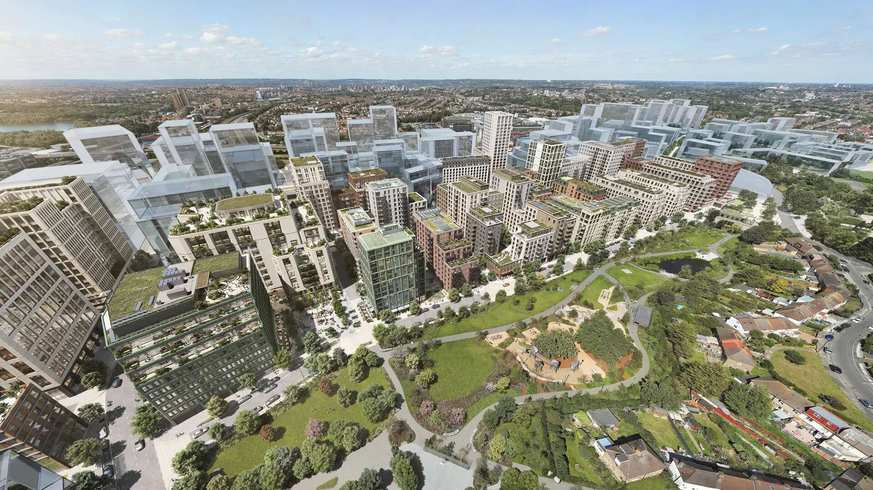
Brent Cross Masterplan

Slide 13
Brent Cross Masterplan
141-hectare masterplan delivering 6,700 homes, 3m sq. ft. of offices, plus schools, parks, and community facilities.
Major transport upgrades including a new Thameslink station, better cycling, walking, and bus routes.
DBA advising across student housing, public realm, build-to-rent, and affordable housing.
Active role in the Access Forum, addressing accessibility queries and producing materials like tactile plans for engagement.

Slide 14
3. York Experience

Slide 15
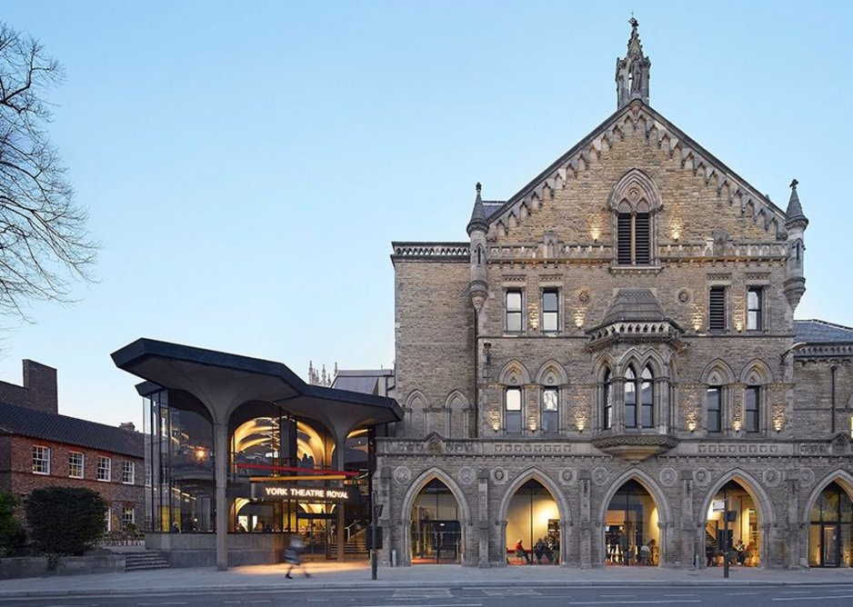
Theatre Royal York

Slide 16
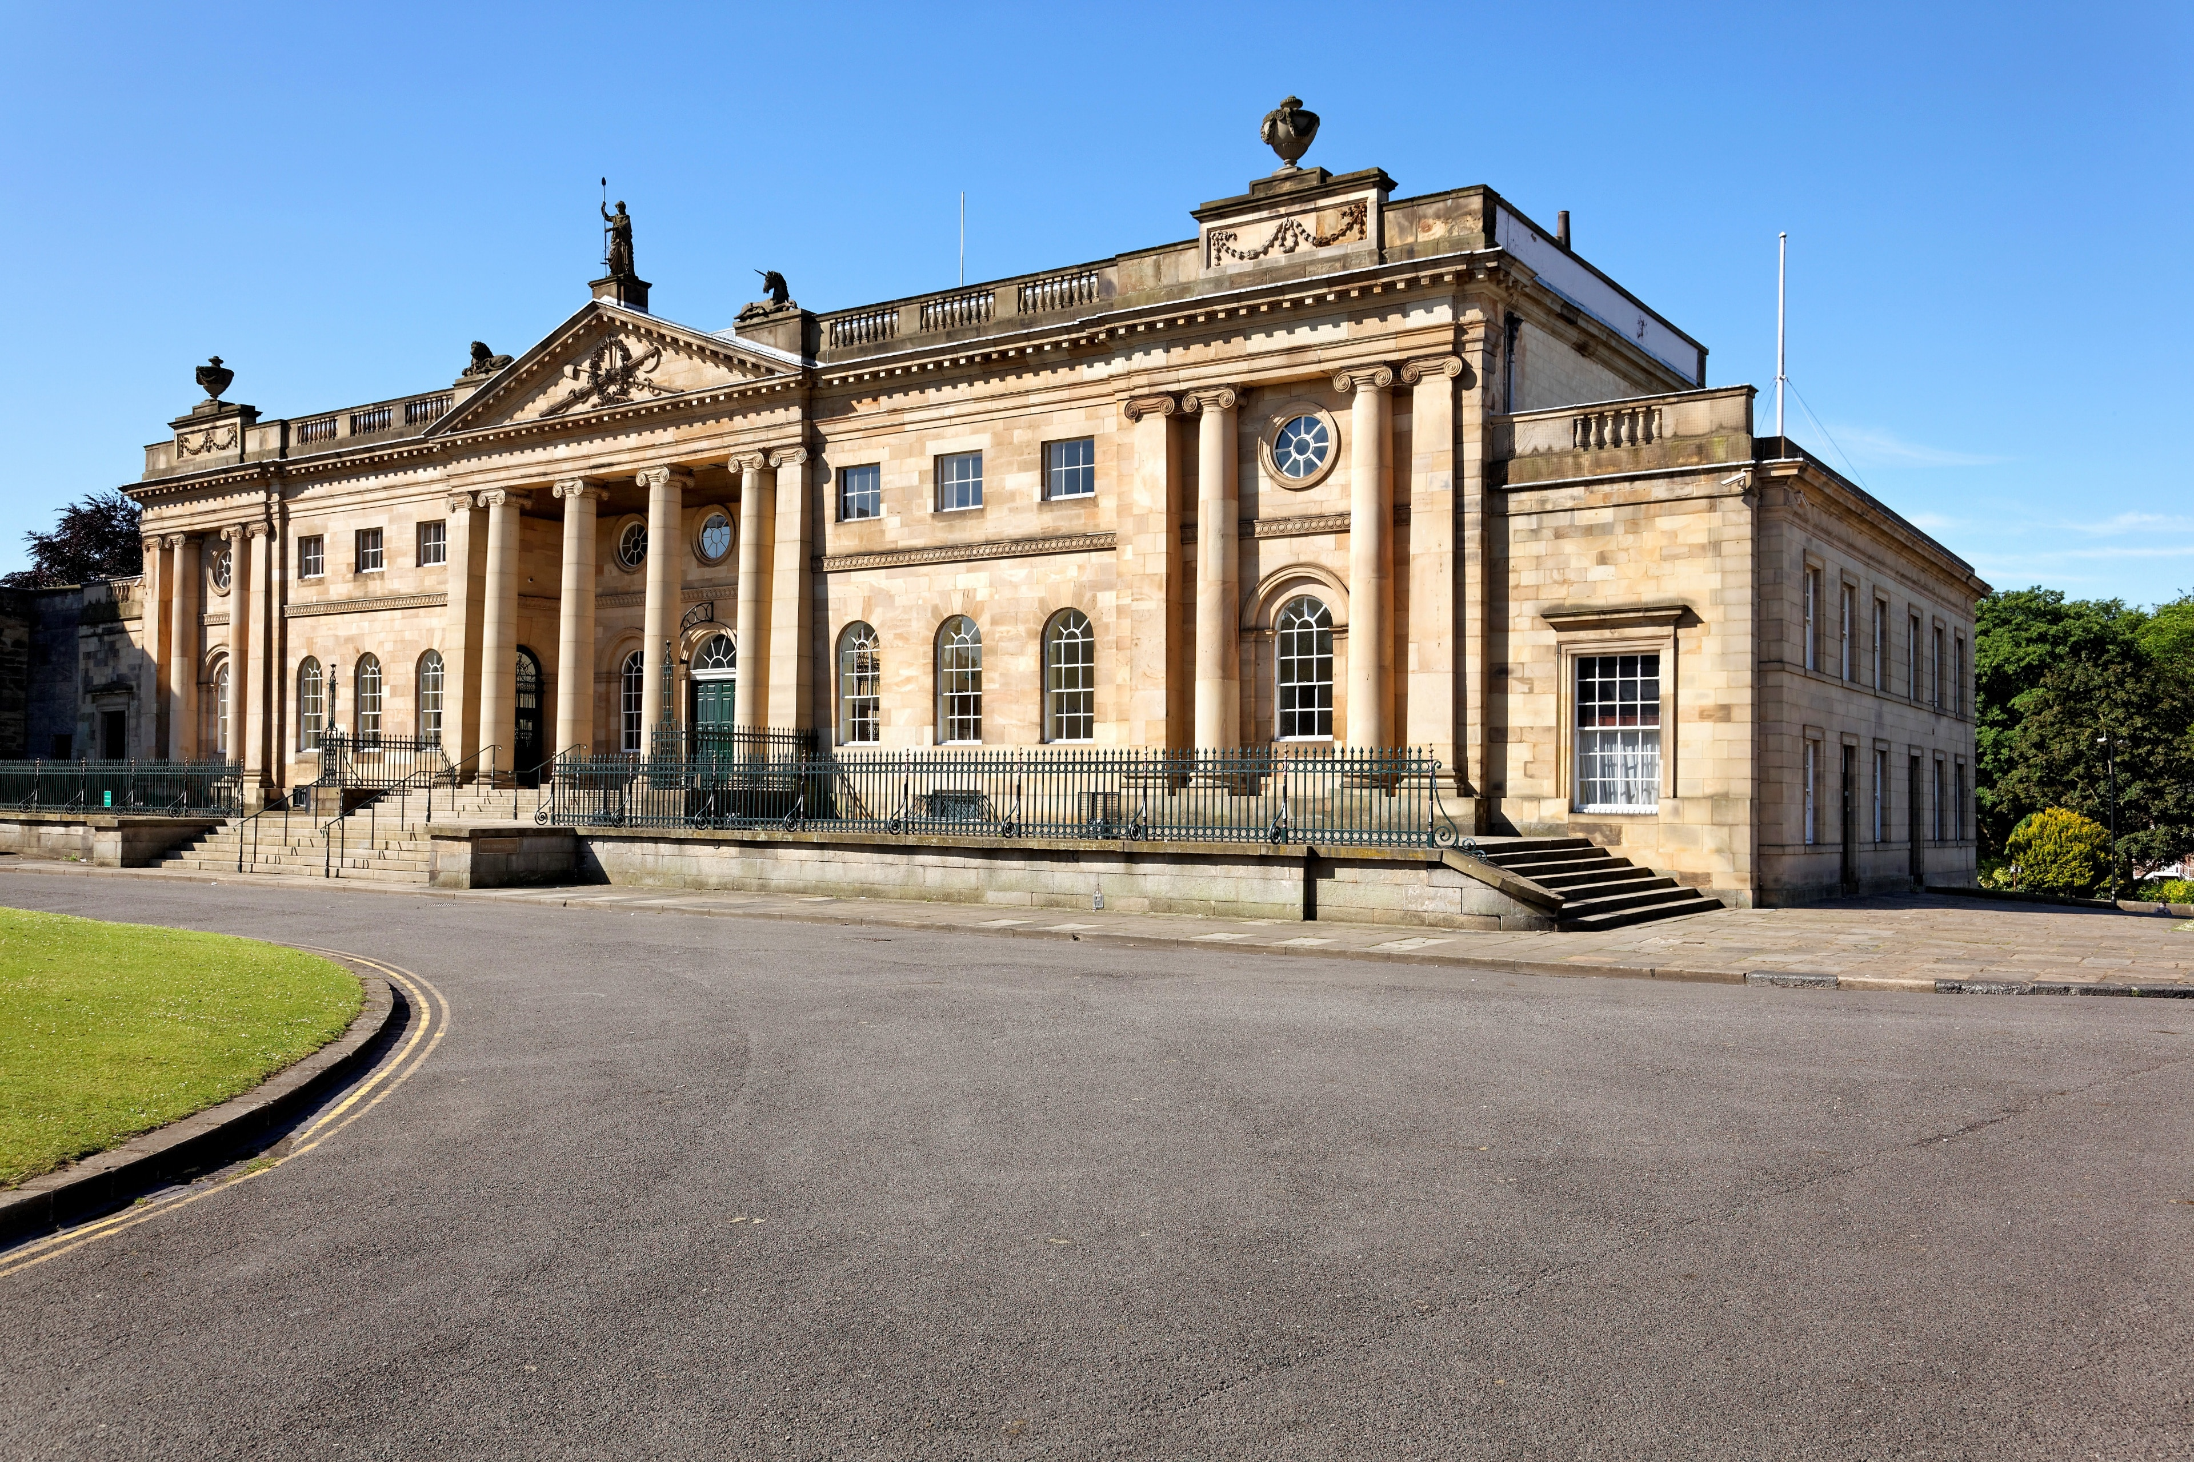
York Castle Museum

Slide 17
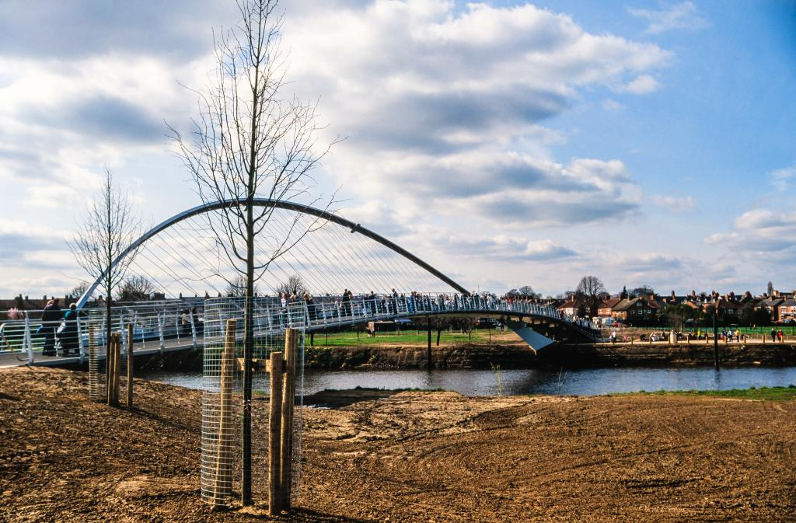
York Millenium footbridge

Slide 18
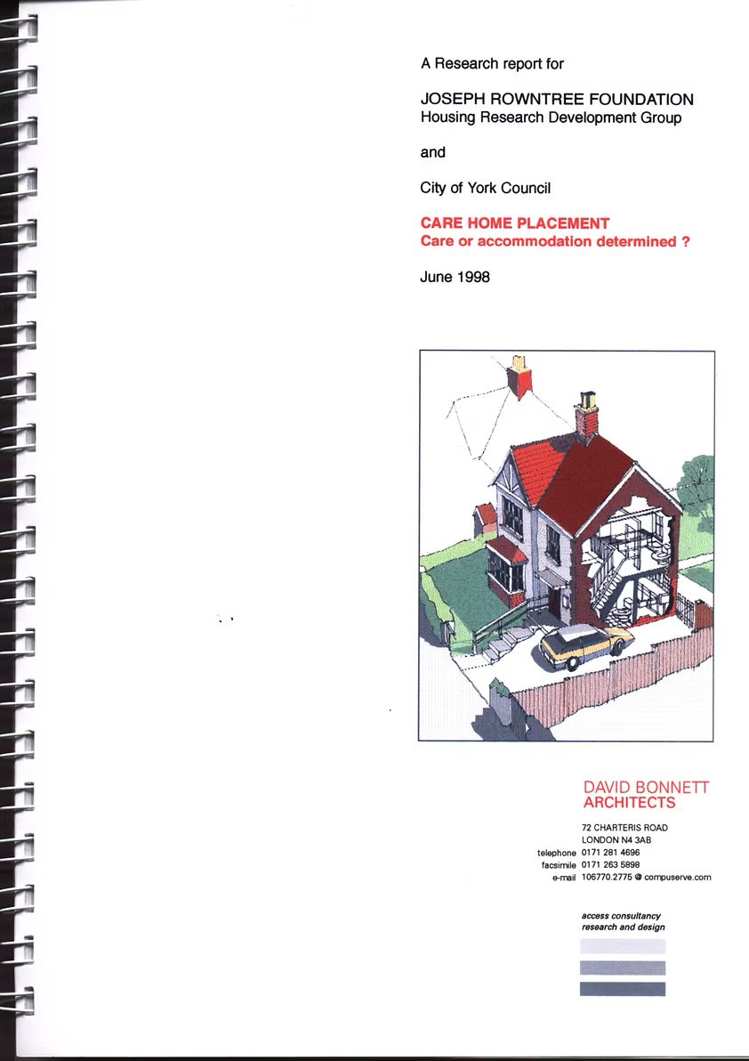

Joseph Rowntree Foundation

Slide 19
4. DBA’s role on
York Central

Slide 20
DBA Role
Act as Access Consultant, reviewing pre-application proposals with respect to inclusive design.
Reviews reference regulatory requirements, best practice, and local planning policy. Process builds trust by flagging issues: green (agreement), amber/red (requiring further discussion).
DBA is not the decision-maker; final decisions rest with York Planning Authority and McLaren.

Slide 21
DBA input to date
Reviewing masterplan strategy and individual plot proposals.
Feedback from the presentation last week and pre-application meeting is under discussion with the client.
DBA attended the July public consultation and will attend again in October.
DBA appointed for RMA Application only, but we are open to re-engaging with the Forum as the design progresses and the client confirms future consultation activity (and our instruction).

Slide 22
Any questions ?

